Slide 1


PDILL - Airflow Implementation Plan

Slide 2
Table Of Contents
What is Airflow?
Architecture Overview
Talk About PDILL DAG
Talk About Code Part
Deployment Strategy
Talk about celery executor
Data Masking Functional Use Case
Non Function Use Case
Success Criteria
Test Cases and Results
Roles and Responsibilities

Slide 3

What is Airflow?
Airflow is a platform to programmatically author, schedule and monitor workflows
Use Airflow to author workflows as Directed Acyclic Graphs (DAGs) of tasks.
The Airflow scheduler executes your tasks on an array of workers while following the specified dependencies.
Rich command line utilities make performing complex surgeries on DAGs a snap. The rich user interface makes it easy to visualize pipelines running in production, monitor progress, and troubleshoot issues when needed.

Slide 4
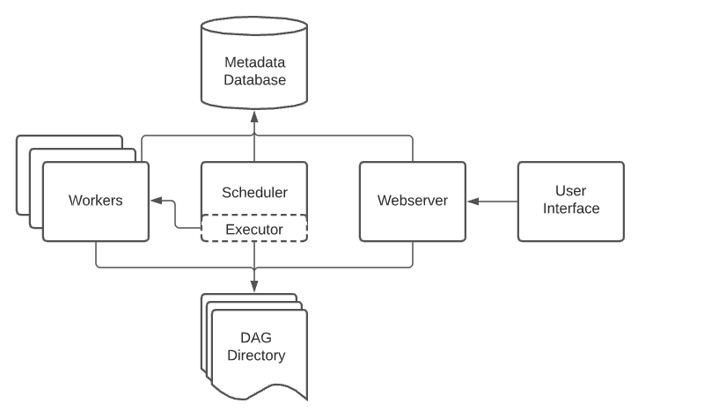
Airflow Architecture Overview
A scheduler, which handles both triggering scheduled workflows, and submitting Tasks to the executor to run.
An executor, which handles running tasks. In the default Airflow installation, this runs everything inside the scheduler, but most production-suitable executors actually push task execution out to workers.
A webserver, which presents a handy user interface to inspect, trigger and debug the behaviour of DAGs and tasks.
A folder of DAG files, read by the scheduler and executor (and any workers the executor has)
A metadata database, used by the scheduler, executor and webserver to store state.

Slide 5
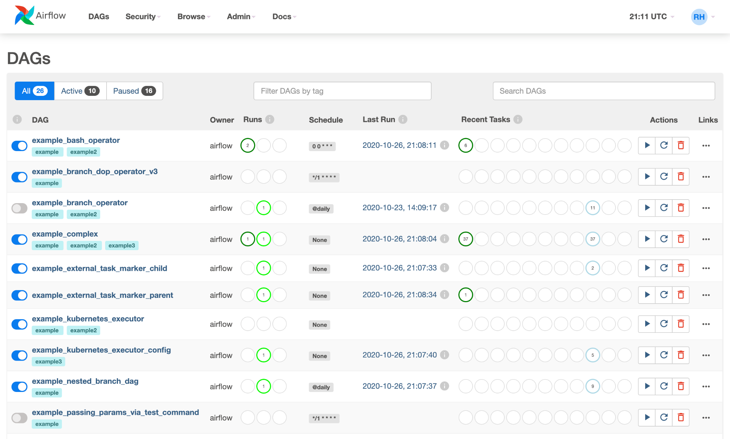
Airflow User Interface
Airflow comes with a user interface that lets you see what DAGs and their tasks are doing, trigger runs of DAGs, view logs, and do some limited debugging and resolution of problems with your DAGs.
It's generally the best way to see the status of your Airflow installation as a whole, as well as diving into individual DAGs to see their layout, the status of each task, and the logs from each task.

Slide 6
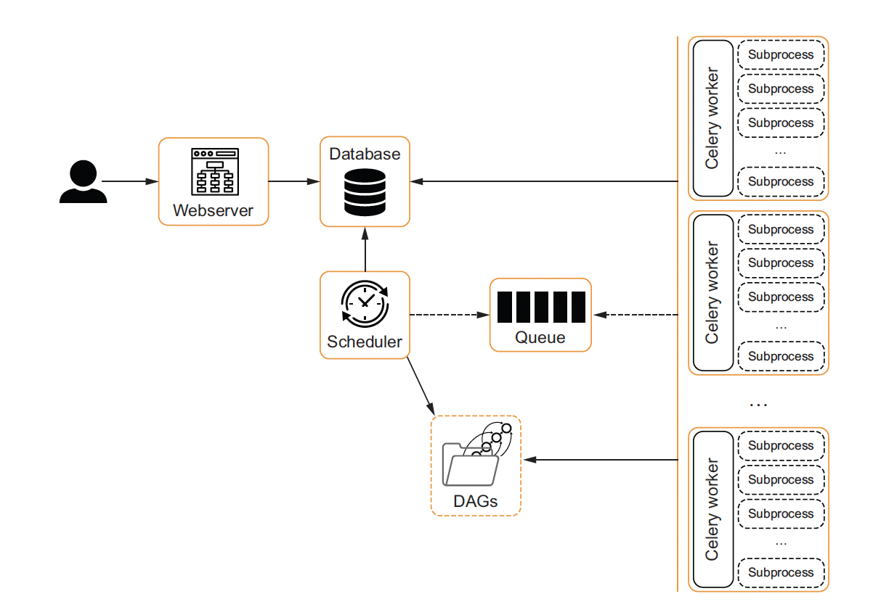
Airflow With Celery Executor
As you can see in figure 12.7, both the scheduler and Celery workers require access
to both the DAGs and the database. For the database, this is not a problem since you
can connect to it with a client. For the DAGs folder, this can be challenging to set up.
You make the DAGs available to all machines either via a shared file system or by
building a containerized setup where the DAGs are built into an image with Airflow.
In the containerized setup, any change to the DAG code will result in a redeployment
of the software.
The queueing system can be anything that Celery supports, which is Redis, RabbitMQ,
and AWS SQS at the time of writing. In Celery, the queue is called broker. Installing a
broker is not in the scope of this book, but after installation you must configure Airflow
to the broker by setting AIRFLOW__CELERY__BROKER_URL:

Slide 7
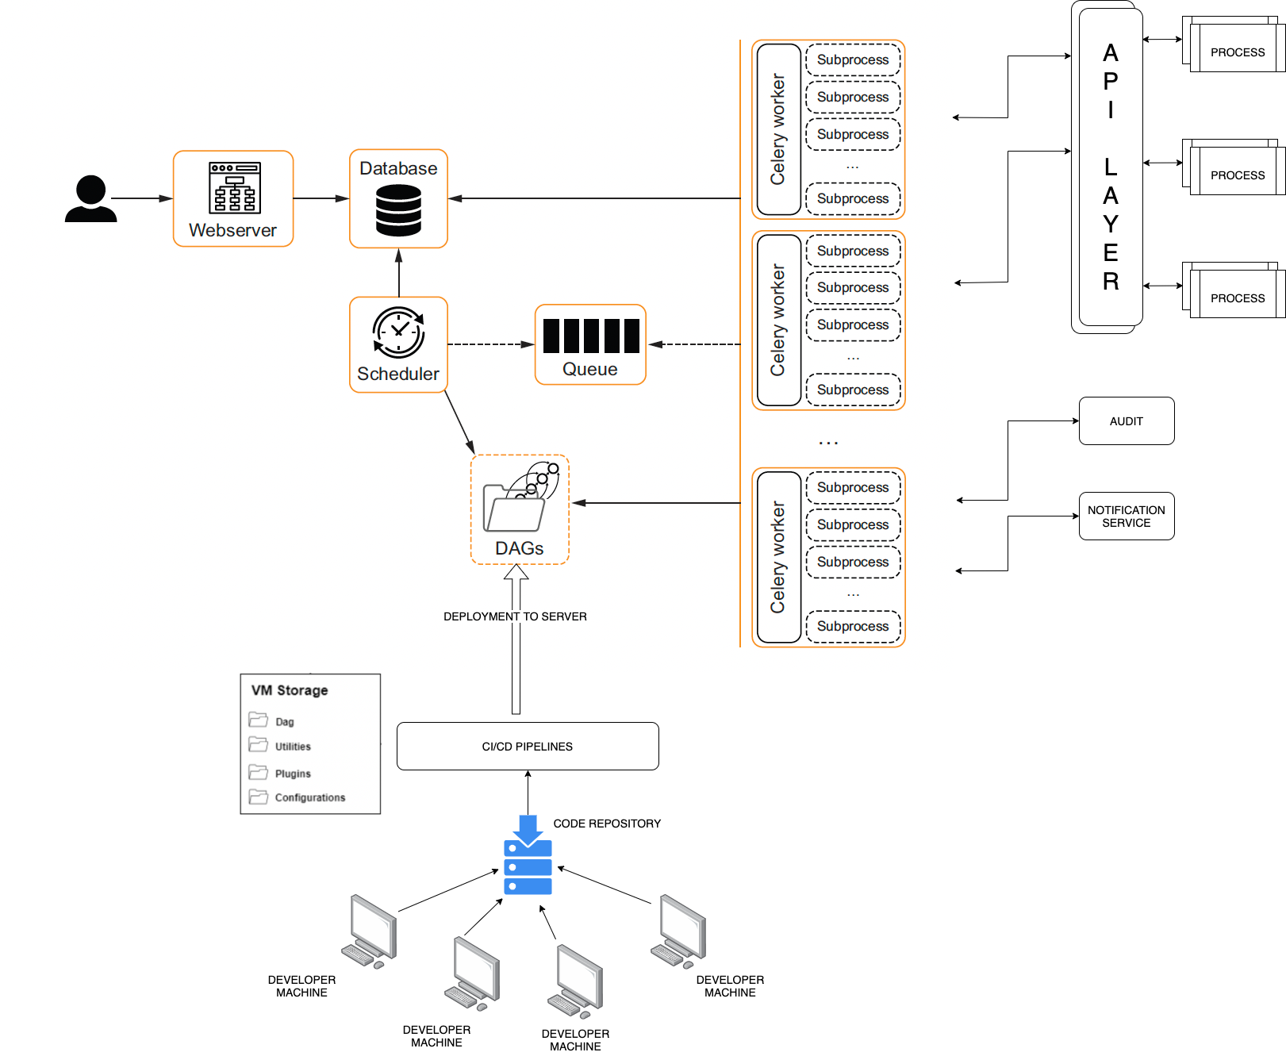
PDILL with Airflow Architecture Overview

Slide 9
Airflow PDILL Solution (TODO)
Enter Screenshot of PDILL DAG
Explain the working of PDILL DAG

